Slide 1


Project 2
BSc(Hons) in Applied Computing (Internet of Things)

Slide 2
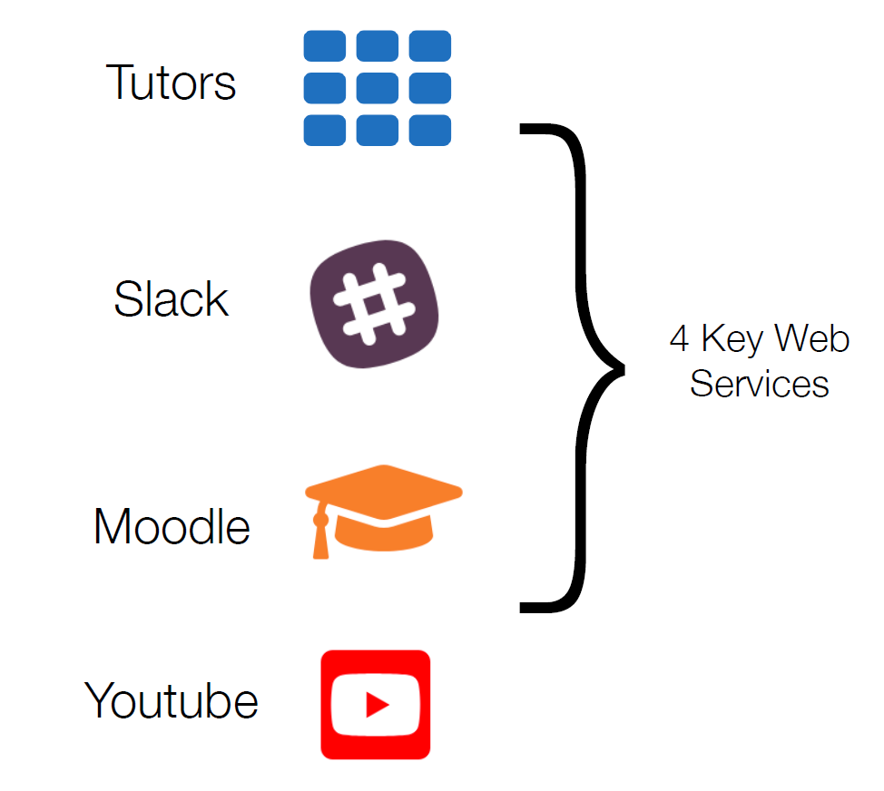

Slide 3
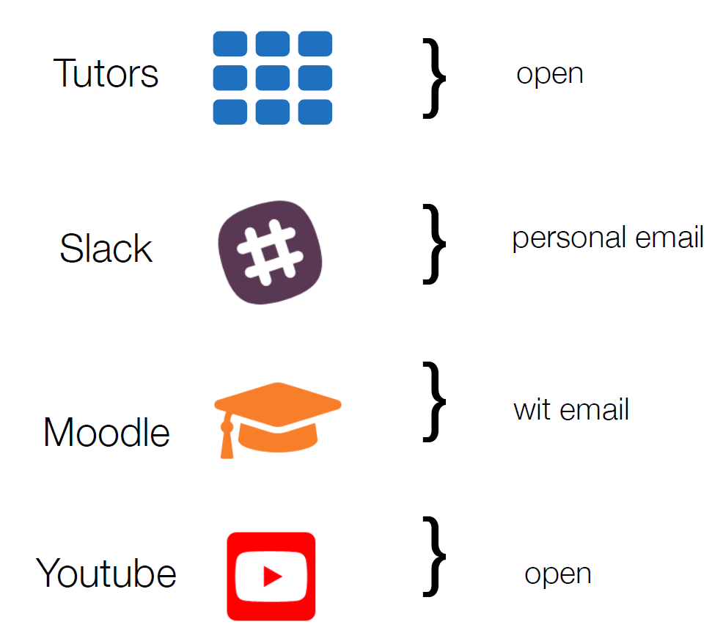

Slide 4


https://tutors-design.netlify.com/course/project2-2020.netlify.com

Slide 5
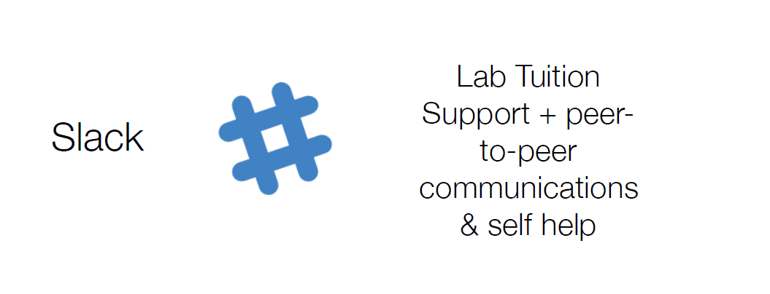

Slide 6
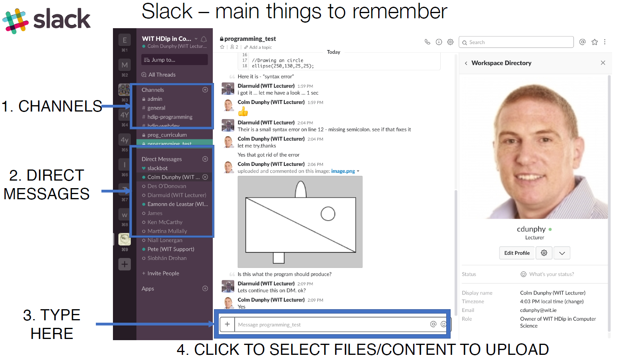

Slide 7
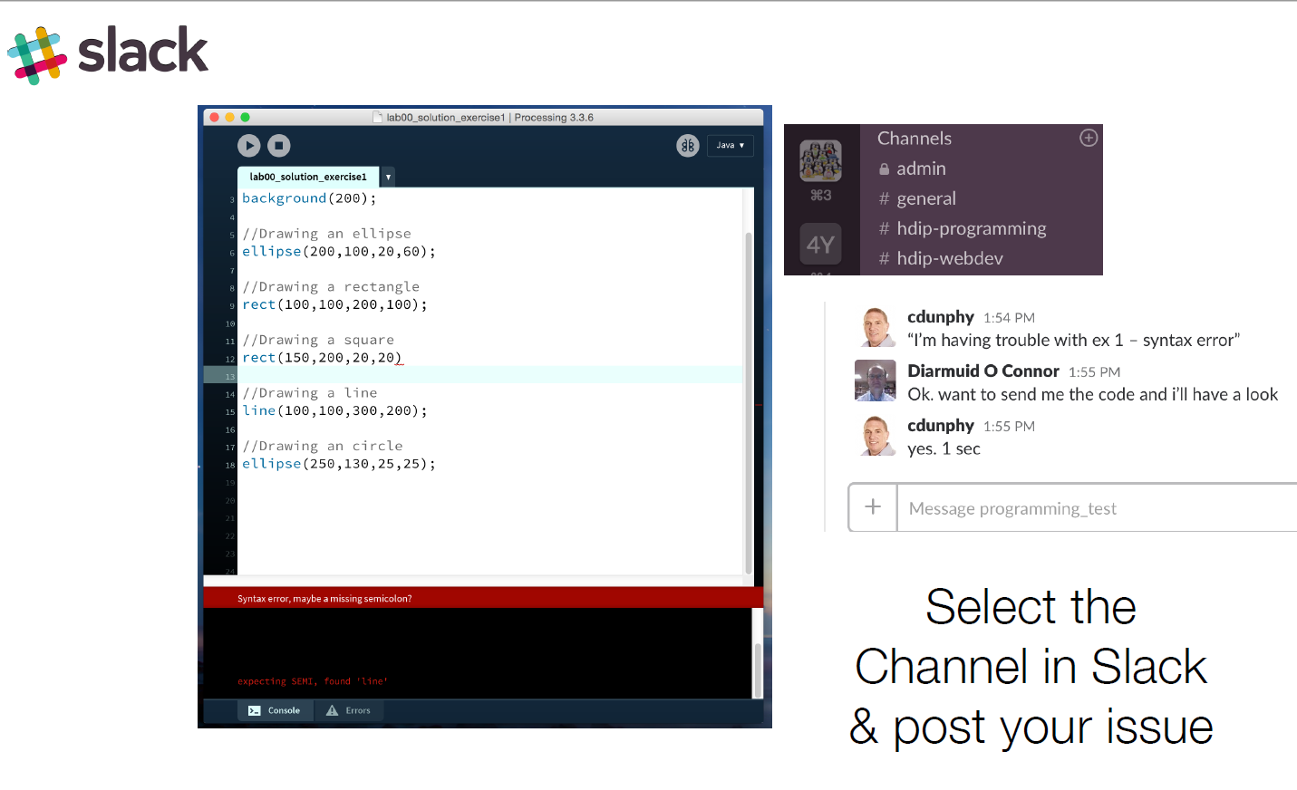

Slide 8
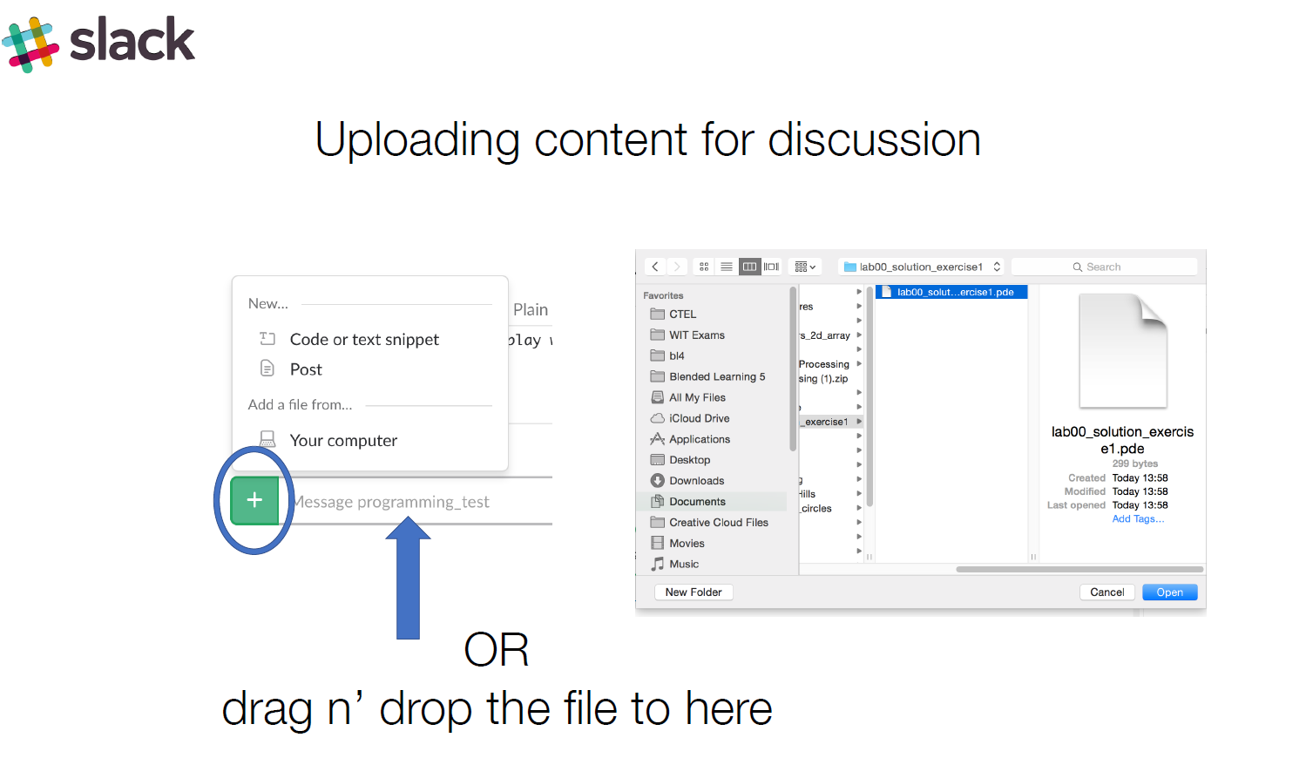

Slide 9
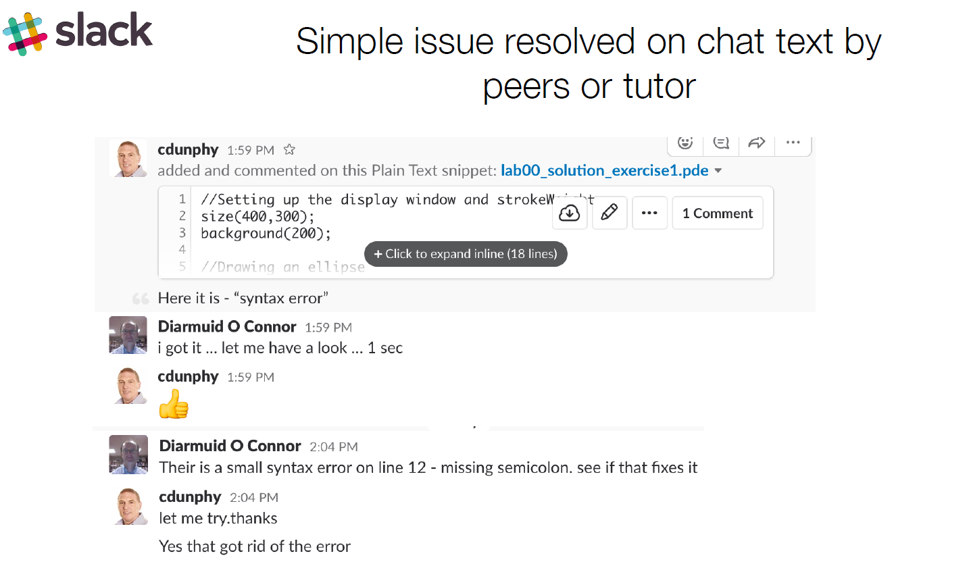

Slide 10
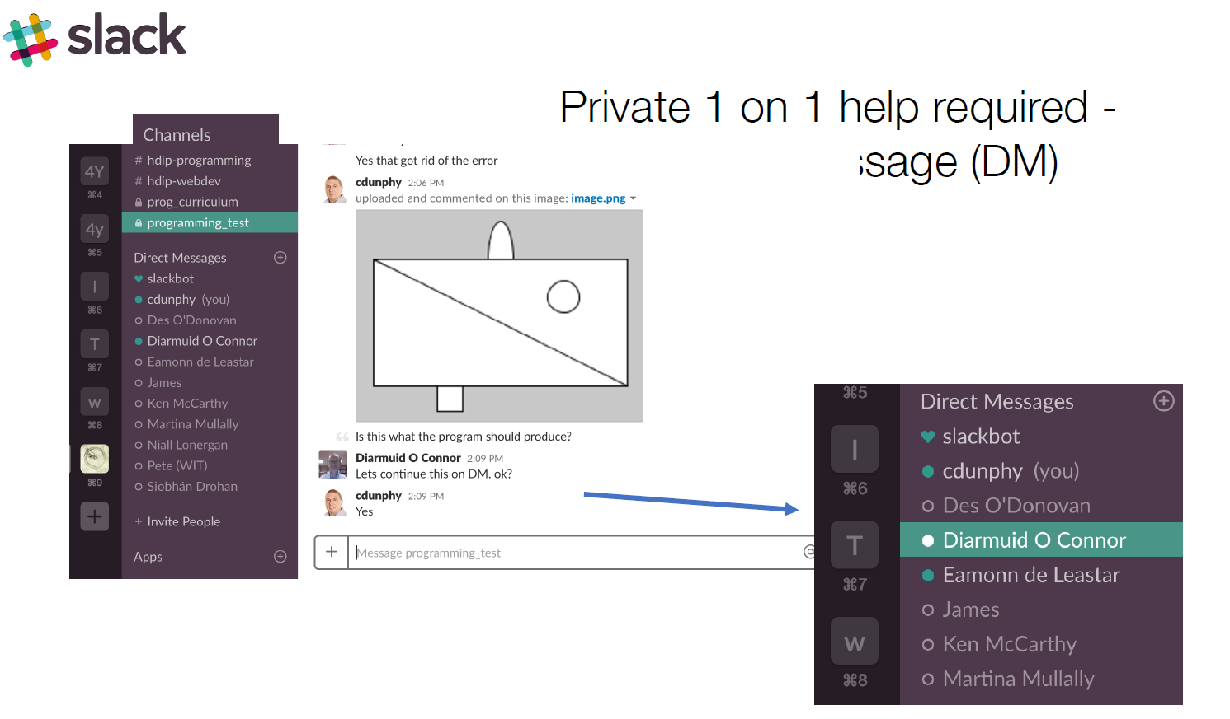

Slide 11
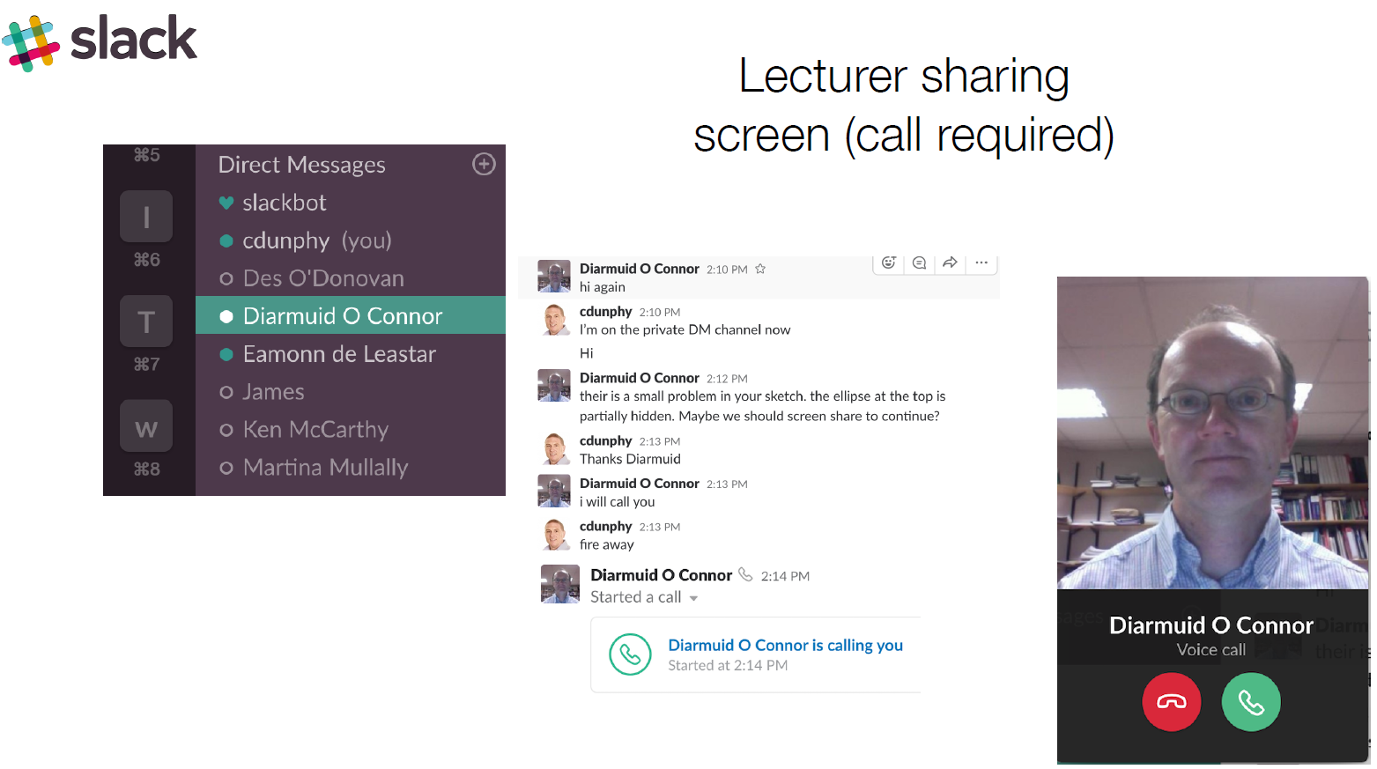

Slide 12
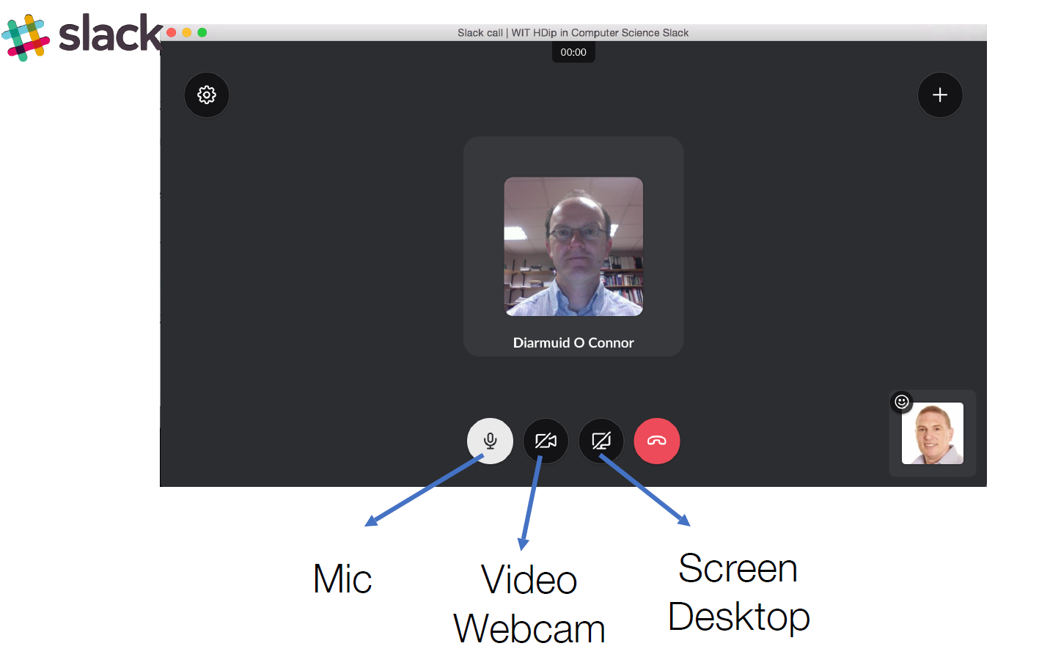

Slide 13
Other Stuff
College accessible on Monday
Equipment ordered

